Slide 1
Predicting Parkinson's Disease Progression
Alisha Kevin
Peter
Sambulo

Slide 2
Introduction
Parkinson’s disease (PD) is a brain disorder that impairs movement, cognition, sleep, and other vital functions. Unfortunately, there is no cure- and the disease worsens over time. It is predicted that by 2037, nearly 1,6 million Americans will be affected by PD, resulting in an economic burden approaching $80 billion.
Research has shown that abnormal protein or peptide activity is a critical factor in the development and progression of this disease. By utilizing data science to gain a more comprehensive understanding, it may be possible to uncover important insights for the development of treatments that could slow the progression or even cure PD.
Notes:
Alisha: Parkinson's disease is a brain disorder that causes unintended or uncontrollable movements, such as shaking, stiffness, and difficulty with balance and coordination. Symptoms usually begin gradually and worsen over time. As the disease progresses, people may have difficulty walking and talking. Prediction say that by 2037 1.6 million americans will be affected by parkinson. Many research has shown that when there is abnormal protein or peptide activities thats when there is a progression and development of the disease.

Slide 3
Objective
Our objective is to predict the progression of PD in patients by analyzing their MDS-UPDRS scores. which measure progression in patients with PD. The Movement Disorder Society-Sponsored Revision of the Unified Parkinson’s Disease rating Scale (MDS-UPDRS) is a comprehensive assessment tool that measures both motor and non-motor symptoms associated with PD.
Our team developed models using data on protein and peptide levels over time in both individuals with PD, as well as in normal age-matched healthy controls. By doing so, we aim to uncover significant insights into the molecular changes that occur as PD advances, potentially leading to a groundbreaking discovery.
Notes:
Our project will predict the progression of parkinson in pt by analyzing their The movement disorder society- Unified PD rating scale.
This scale is an assessment tool that measures both motor and non motor symptoms.
My team has developed models using data on protein and peptide levels over time in both pt that have PD and the non PD pt. Further in our presentation you can visualize the that we have uncovered the significant insights into the molecule changes that occur as a pt who has advanced PD.

Slide 4
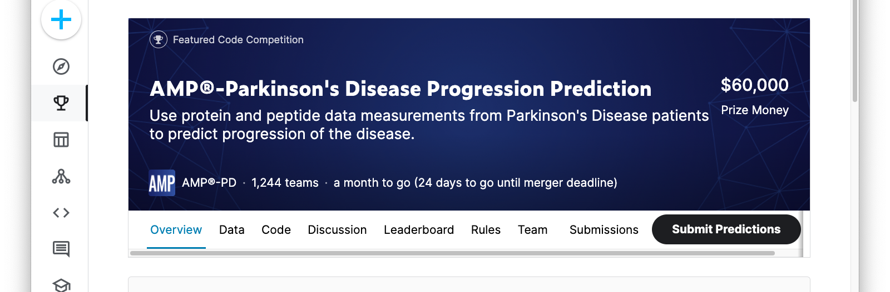
Kaggle Competition
For each patient visit where a protein/peptide sample was taken you will need to estimate both their UPDRS scores for that visit

Slide 5
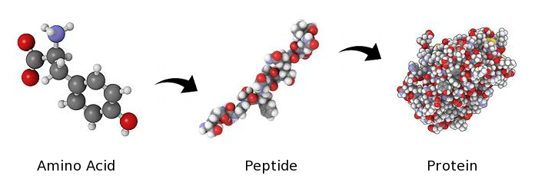
Protein Vs Peptide
Peptides and Proteins are amino acid chains that differ in size, structure, and function.
Peptides are shorter and have various roles such as hormones or antimicrobial agents.
Because peptides are shorter and smaller they are even easier for the body to absorb and use.
Peptides are able to easily penetrate the skin and intestines, allowing them to enter the bloodstream quickly and efficiently.
Proteins are longer, more complex, and can have specialized functions like enzymes, transporters, or structural support.
Notes:
alisha

Slide 6
Data Preparation
From Kaggle we downloaded the protein, peptide and clinical data that we want to work with.
After downloading the dataset, we created a new SQLite database. Then, we uploaded the data into the database.
Next, we used the Python library sqlite3 to connect to the database and retrieve the data by executing SQL queries.
Once we have the data, we performed necessary data cleaning and preprocessing steps, such as removing duplicates, handling missing values, and converting data types.
Finally, we saved the cleaned data to a new CSV file using the Python library pandas. We read the cleaned data into a pandas DataFrame and then use the to_csv() method to save it to a new CSV file.

Slide 7
01
Data Exploration

Slide 8
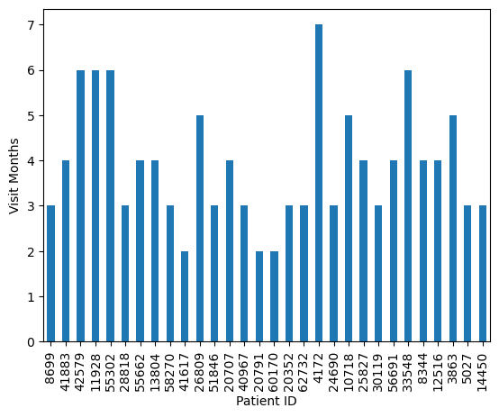
Random Selection of how many times a certain Patient has visited the clinic for a follow up check up due to its symptoms.

Slide 9
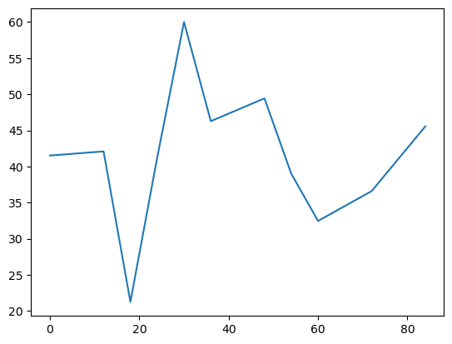
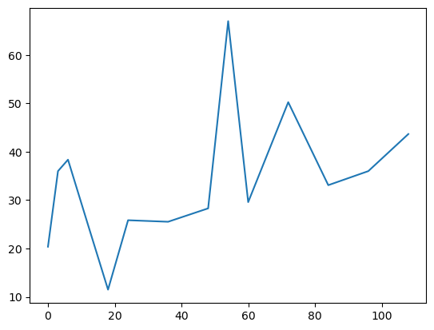
Severity of symptoms based on Drug & Placebo
Patient Sum score based on given the placebo
Patient’s sum score on the drug
Notes:
As you can see on this side. These 2 graph shows the amount of time a patients have visited the clinic based on the month due to there symptoms.

Slide 10
02
Feature Engineering

Slide 11
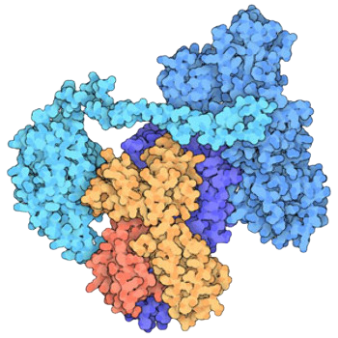

Features Engineering
Black Box
Protein Abundance
Patients
Individuality of PK
Drugs
Peptide Abundance

Slide 12
03
Baseline Models

Slide 13

Feature Selection & Baseline Models
Black Box Model
Correlation against Disease progression
Covariance features
Experiment with different
thresholds.
Cross-Validation to evaluate models
Total Number of Features: 1445
Notes:
Cross validation is a technique for evaluating the performance of a machine learning model by training and testing it on different subsets of the available data.

Slide 14
04
Optimization

Slide 15
Top Model Shows Relative High Standard Deviation and Suggest Overfitting
Average MSE | STD | # of Features
82 | 9 | 1080
90 | 6 | 1240
92 | 6 | 1181
92 | 7 | 1102
94 | 10 | 382
101 | 21 | 754
HyperOpt
MSE on train - 0.47
MSE on test -
32.54
80/20

Slide 16
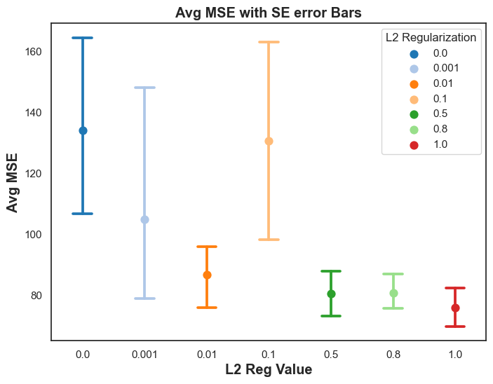
L2 Regularization (Strength of L2) Lambda value lies between 0.5 and 1
Before L2
After L2
MSE on train - 0.47
MSE on test -
32.54
MSE on train -
28.11
MSE on test -
36.12
Notes:
A higher lambda value will result in a stronger regularization, which means that the model's weights will be penalized more heavily and tend to be smaller, leading to a simpler and more generalized model that is less prone to overfitting but may also have higher bias.

Slide 17
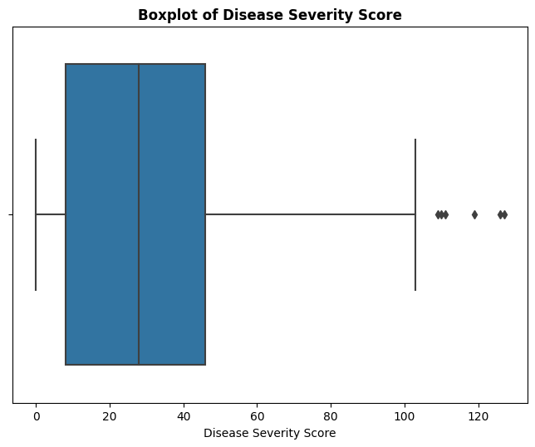
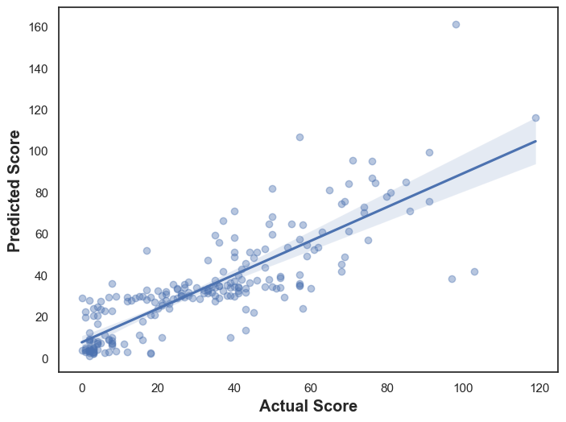
Moderate Correlation between Predicted and Actual with R2 value of 0.65, with better performance for lower scores

Slide 18
The End!

